Slide 1
Market Analysis
Session 4
Amy, Judha, Victoria
November 18, 2022
Notes:
Change the slide background colour to any of the Primary colours (except yellow)

Slide 2

SCOTIABANK DIGITAL BANKING DECK TEMPLATE
Agenda
01
02
03
Tech bursting
Inflation
Retail market & the holiday outlook

Slide 3

Congrats on the top 3 so far

Slide 4

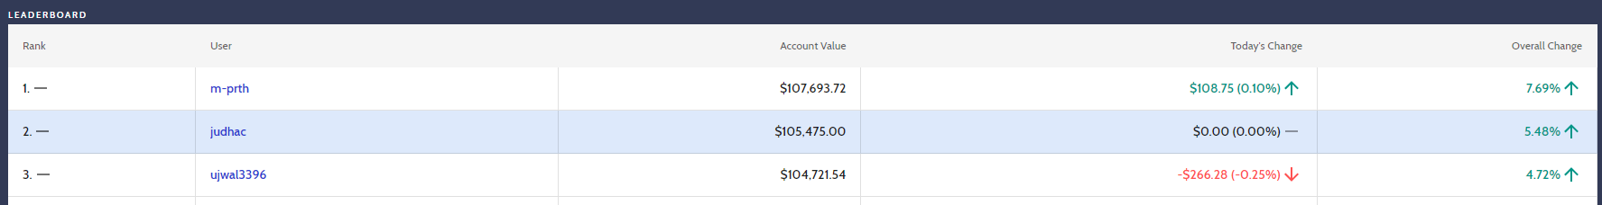




00 SUBSECTION NAME
4

Slide 5
01
What is going on with big tech
Notes:
Don’t be afraid to change the background colours! Under the ”design” tab select “format background”. Change the background colour to one of the fun new Scotia colours!

Slide 6
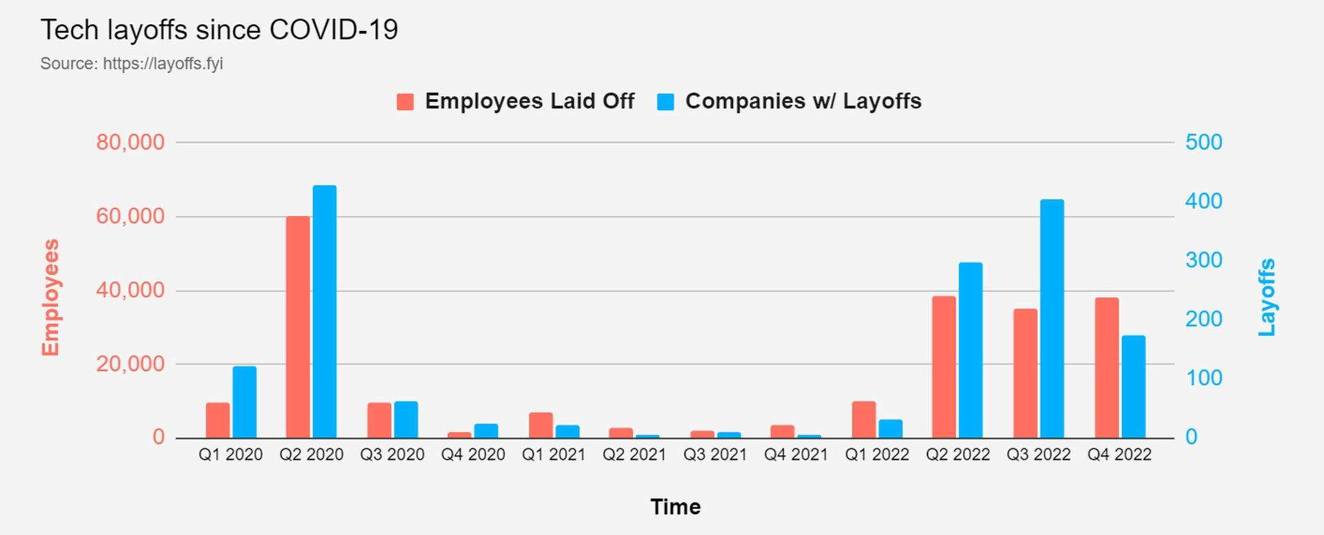
00 SUBSECTION NAME
6
A perfect storm?
Rising interest rates
The flood of money is receding. Prudence.
Too much spending…
Lets cut costs!
Where?
Employees!
Advertising!
Misreading demand
What happened to the pandemic?
Pandemic demand has gone down.
Projected growth after pandemic never materialized fully – especially with a potential recession
Problem? Too many employees for a demand that never came.

Slide 7
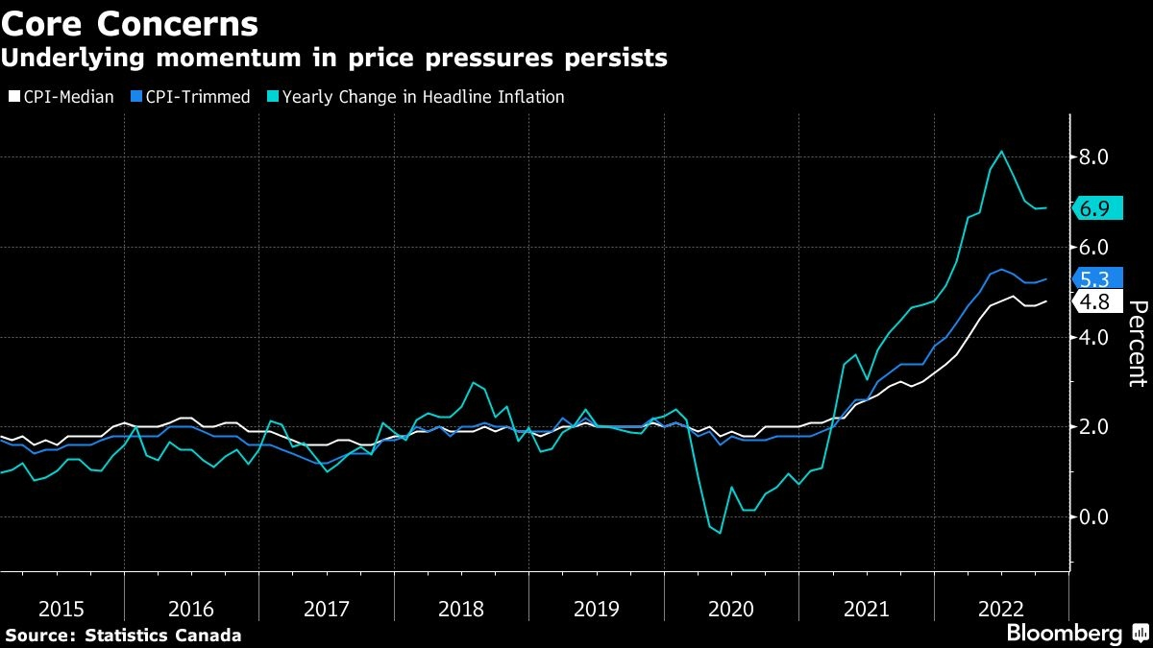
00 SUBSECTION NAME
Inflation
-On Nov 16, BoC announced CPI(Consumer Price Index) rate for October
-Increased 6.9% Y/Y, higher than expected of 6.5%
-Increased 0.7 M/M, which was largely driven by rose in gasoline price
-gasoline price increased 9.2%, mainly affected by the future oil production cut, and weaker Canadian Dollar

Slide 8
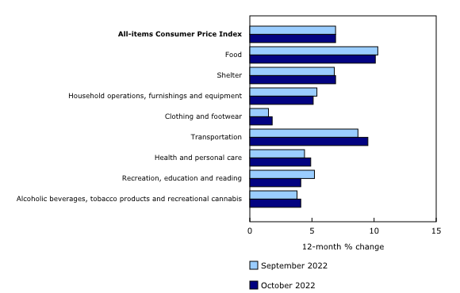
00 SUBSECTION NAME
Inflation
-Rise in price for groceries slowed down, but continues to escalate
-Wage rose 5.6% on October, price is still growing faster than wage
-Mortgage lending rate rise 11.6 Y/Y
-Canada’s two-year treasury yield rose to 3.877%

Slide 9
Inflation, although cooling, is still very high
Inflation and high interest rates have affected sales in the retail sector
In the last quarter, retailers have experienced increased inventory due to decreased consumer spending
Retail Market

Slide 10
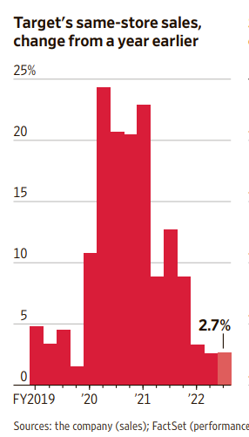
On Wednesday, Target reported below-expected quarterly sales
Inventory rose 14% in October, while sales growth did not meet this number
Target executives slashed financial goals for the next quarter which ends their fiscal year
CFO, Michael Fiddelke, says Target is committed to cleaning up inventory by EOY
If consumer spending trend persists, this means heavy discounts
Retail giant: Target
Looking at competitors ….
Walmart inventory also up 14% but they reported strong revenue and sales growth ; Walmart stocks rallied on Tuesday
Retails like Lowes (home improvement) and Ross Stores (discount apparel) raised their fiscal outlooks ; their stocks soared this week

Slide 11
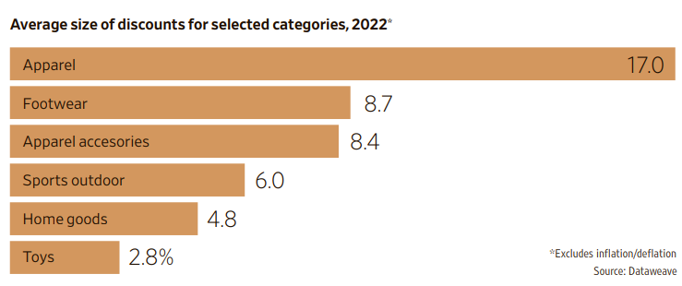
Target is not the only retailer facing excess inventory and slow demand
In the past 2-3 years, the pandemic and supply-chain crisis made products scarce
Retailers marked-up inventory, easily selling items at or above full price
This year, consumer spending diminished, especially on non-essentials like fashion apparel
Retail chains are facing pricing pressure – discounting = lower profits
Pricing Pressure
Outlook …
Good news for holiday shoppers – many retailers will be, or have begun, discounting items to sell off their inventory
As a customer, expect nice and full shelves ; Steve Passierb – president of manufacturing at the U.S. Toy Association – says “the script has been flipped … from a supply-chain standpoint, it’s the opposite of last year”
Not great news for the companies or retail investors – lower profits means stock prices will likely take a hit as well

Slide 12
Discussion
Tech has always been seen as “immune” to macro trends –think 2008. Now its flipped around. The rest of the economy is chugging. What happened?
With current CPI report, what would you predict on the next interest decision on Dec 7?
Retail stocks – what are your thoughts … a buy?
What do you think consumer spending data will look like in 2023? With a looming recession, will spending adequately weaken as per the Feds/BoC’s goal?
What retailers do you think will thrive in the coming months … who are you betting on???

Slide 13
Thank you

